Slide 1
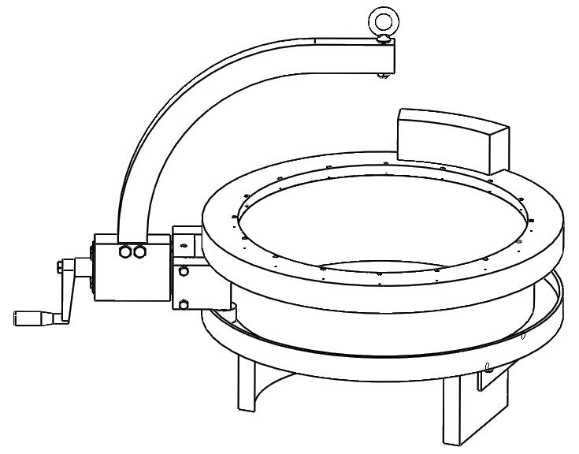
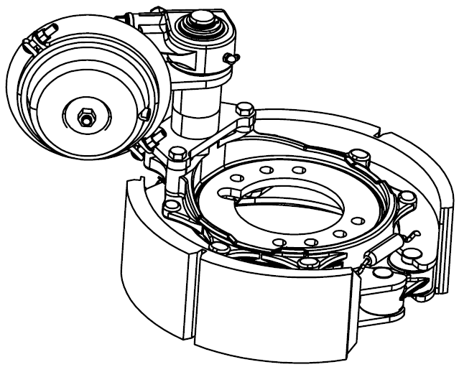
Brake Drum Manipulator
Chris “that guy” Adams
Alex “Terminator” Bakos
Ryan “FLAVOR” FLAVEll
Leo “more horsepower” Gomez

Slide 2
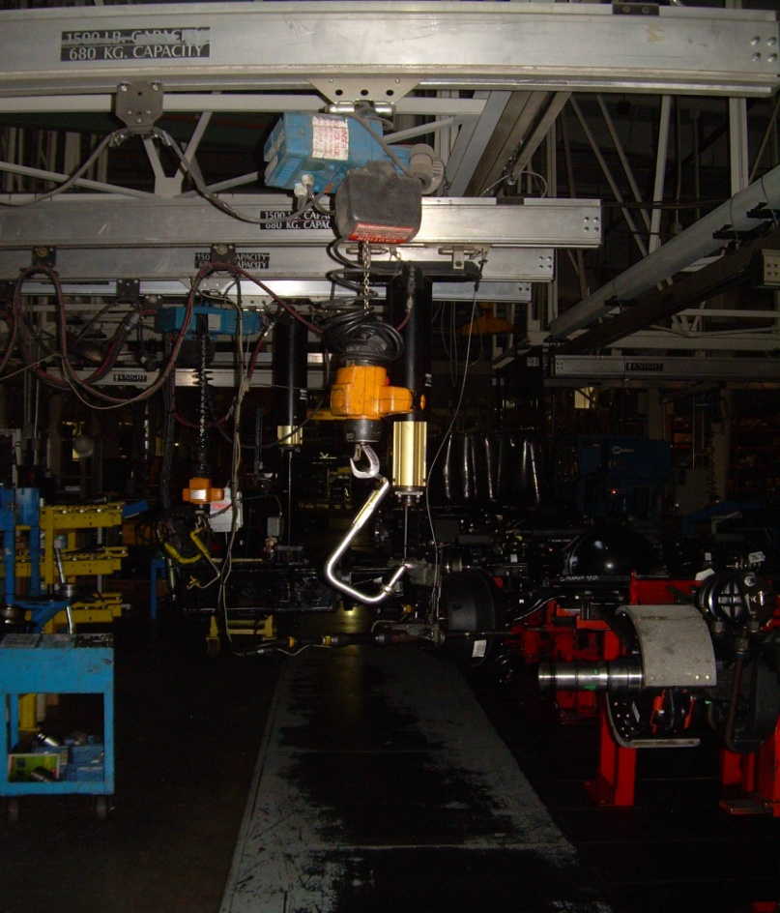
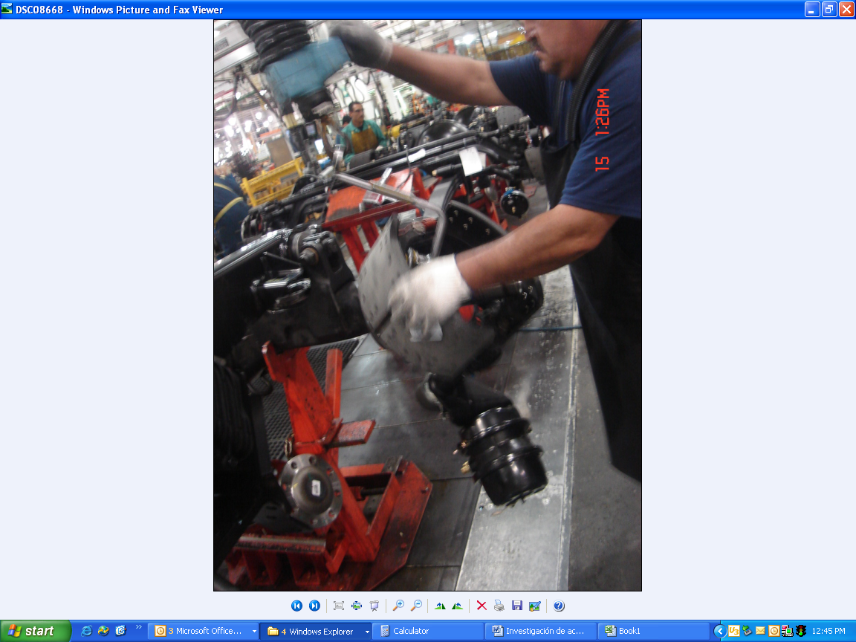
Design Requirements/Objectives
The main purpose of this system is to improve
ergonomics, increase productivity, and safety.
Newly designed equipment should aid
and be strong enough for lifting and
manipulating brakes assembly.

Slide 3
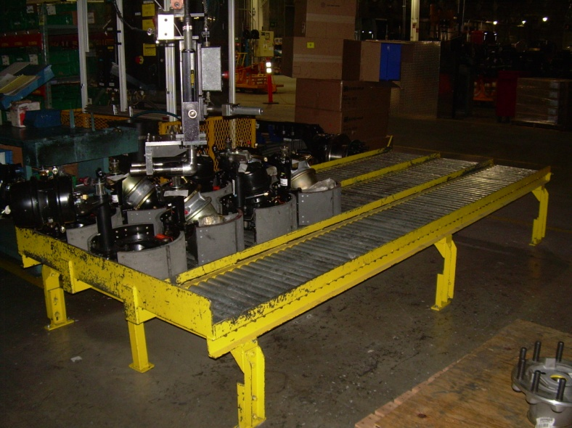
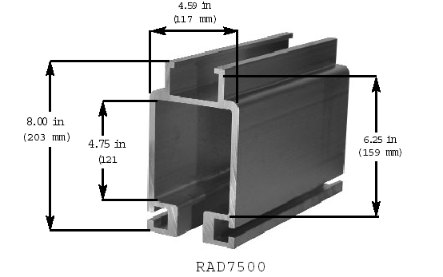
Design Requirements/Objectives
The manipulator must be able to pick up brake assembly from gravity roller conveyor and orient the assembly for installation on the axle.
Manipulator must work with the current
over head system which is an
aluminum 7500 Knight bridge.

Slide 4
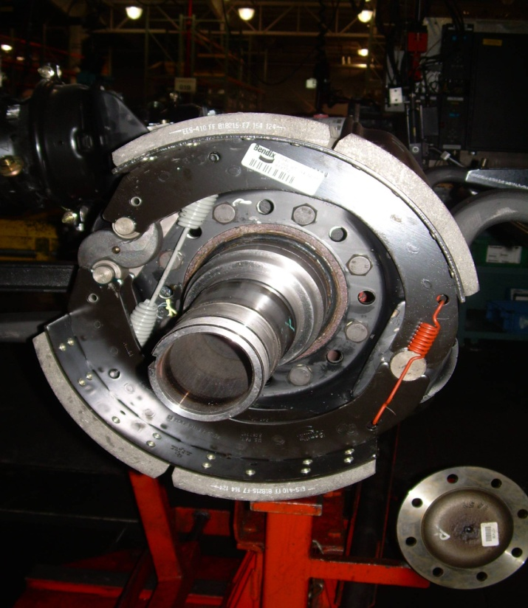
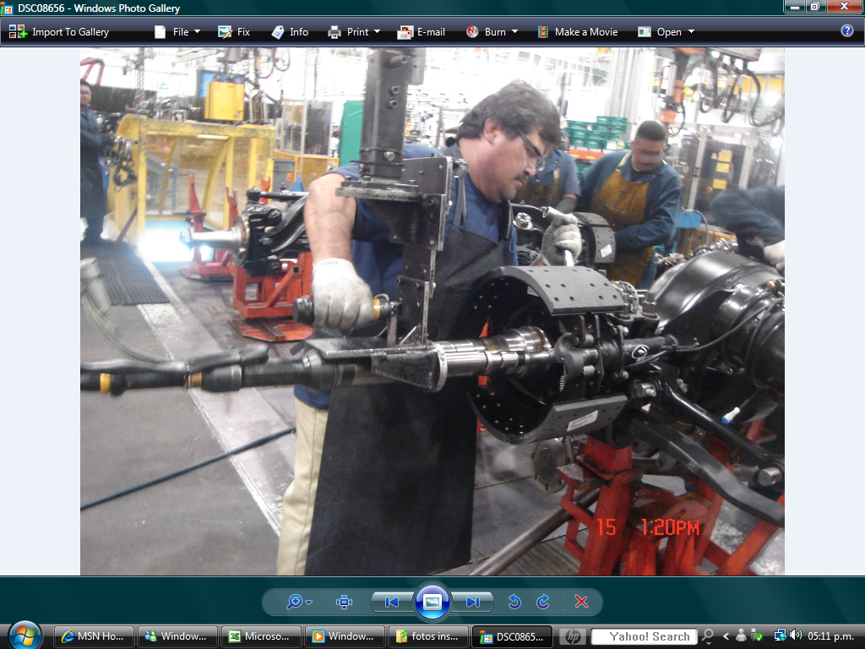
Design Requirements/Objectives
Air brake chamber must be mounted inboard of the brake assembly as shown.
Manipulator will be able to rotate, tilt and lift to take off and install brake assembly from input gravity roller conveyor to install on axle.

Slide 5
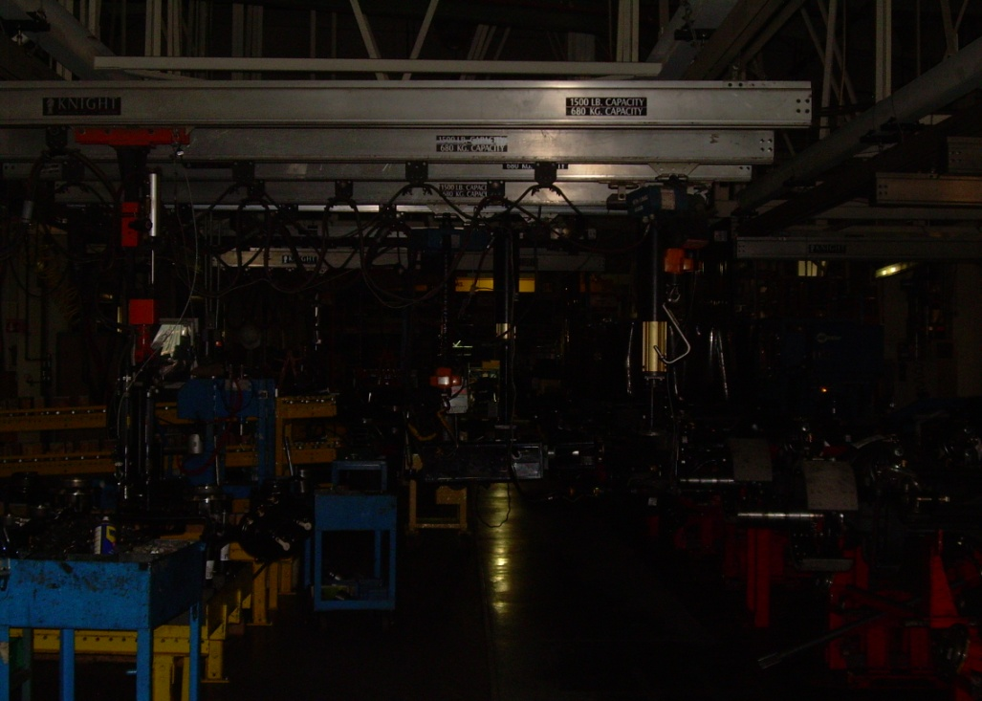
Onsite facilities and utilities
Electrical, pneumatic, rail system, etc.
Roller Gravity Conveyors
Bridges For Manipulators
Temperature: | Normal (70-85 degrees)
Electrical: | 460V 3ph
Air pressure: | 91-110 psi
Current handling method: | Crane
Cycle time: | 3 minutes/1 Kit
Assembly lines: | 1
Assembly shifts | 2
Days/week | 5
Days/year | 250
Trucks/shift | 30
Trucks/day | 60
Trucks/year | 15000

Slide 6
Design system break down
Securely clamp the brake assembly (~105 lbs) to manipulator assembly.
Once clamped lift the brake assembly off the roller conveyor (24 inches off the ground) to the height of the axel assembly (44 inches off the ground), a span of about 20 inches.
At axel height, tilt the assembly 90 degrees so that air brake chamber (pumpkin) is inboard in the axel.
Upon tilting the drum brake assembly 90 degrees, the axle will be rotated to a 3 o’clock position to facilitate the stud assembly.
Brake drum assembly must be securely held on hub to allow two studs to be inserted and tightened down before releasing from manipulator.
Release brake drum without causing damage to part, equipment or personnel.

Slide 7
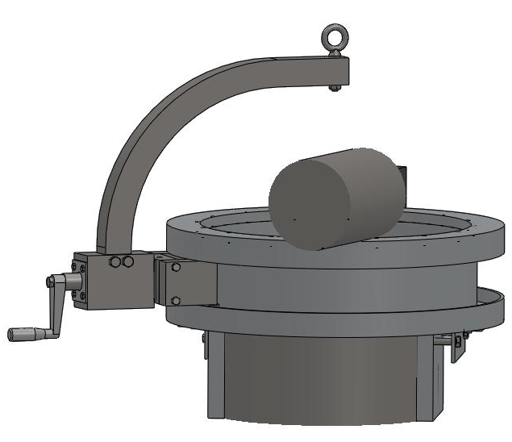
Subsystems
Clamping onto the Drum
Linear movement
Tilt the Drum 90 degrees
Rotating Drum about the Axle

Slide 8
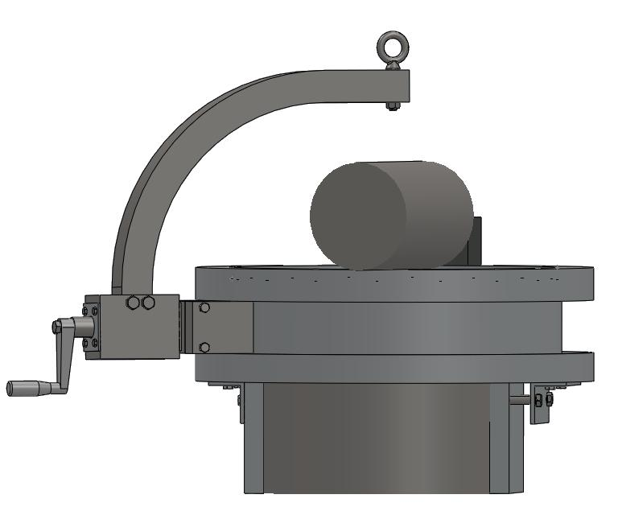
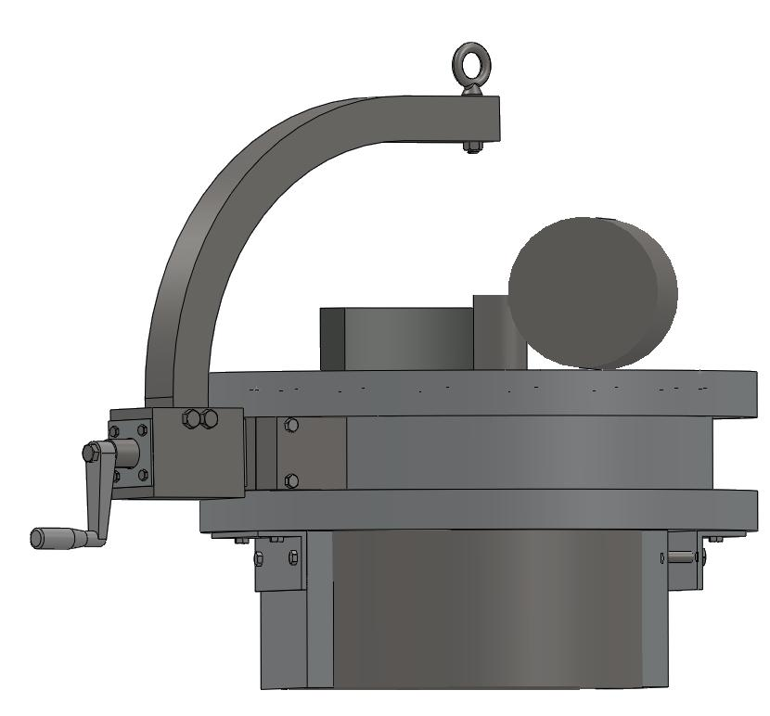
Clamping onto the Drum

Slide 9
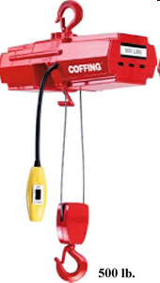
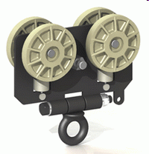
Linear movement
The linear movement consists of a winch that will move the brake assembly
from the gravity roller conveyor (24 inches off the ground) to the height
of the axel assembly (44 inches off the ground), a span of about 20 inches.
Model No.* | Product Code | Rated Cap. (lbs.) | No. of Chains | Std. Lift (Feet) | Lifting Speed (FPM) | Motor H.P. | Voltage & Phase (AC) | A Dim. | Housing Dim. (in.) H x W x L | Shipping Weight (Lbs.) | Price
EMW-500B** | 07612W | 500 | 2-part wire rope | 10 | 10 | 1/6 | 115V. 1 pH | 13 3/4 | 4 3/8 x 6 3/8 x 14 1/4 | 19 | $748
Notes:
The primary responsibility of the linear movement subsystem is to lift and lower the manipulator arm carrying the brake drum to the axle.
It must reliably maintain this height while traveling to the axle and bring it level to the height of the axle. While lifting and transporting, the subsystem
must be rigid to prevent against swaying while traveling.

Slide 10
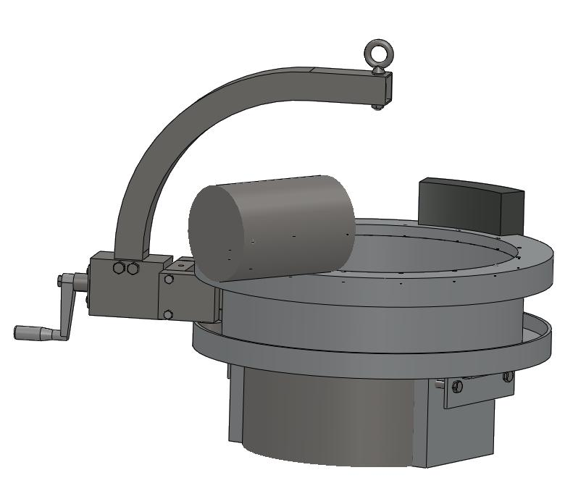
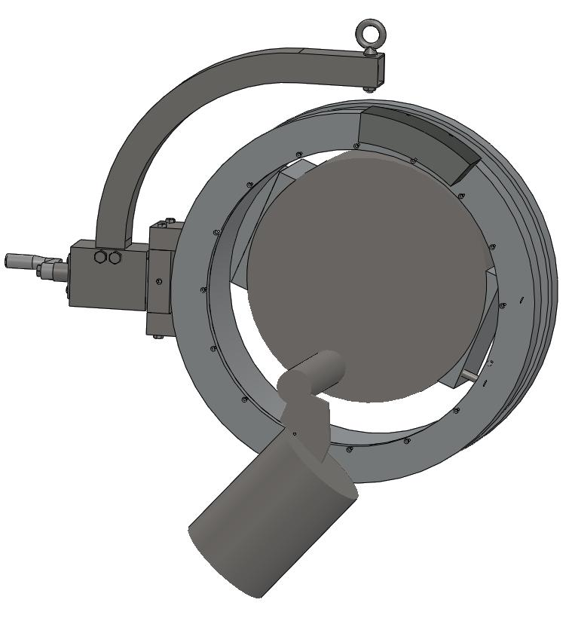
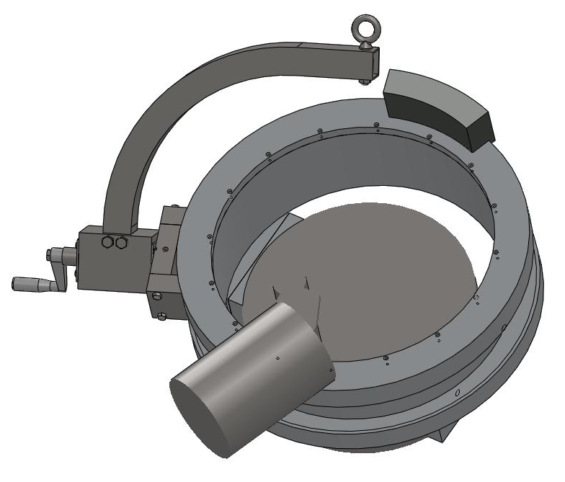
Tilting the Drum 90 degrees

Slide 11
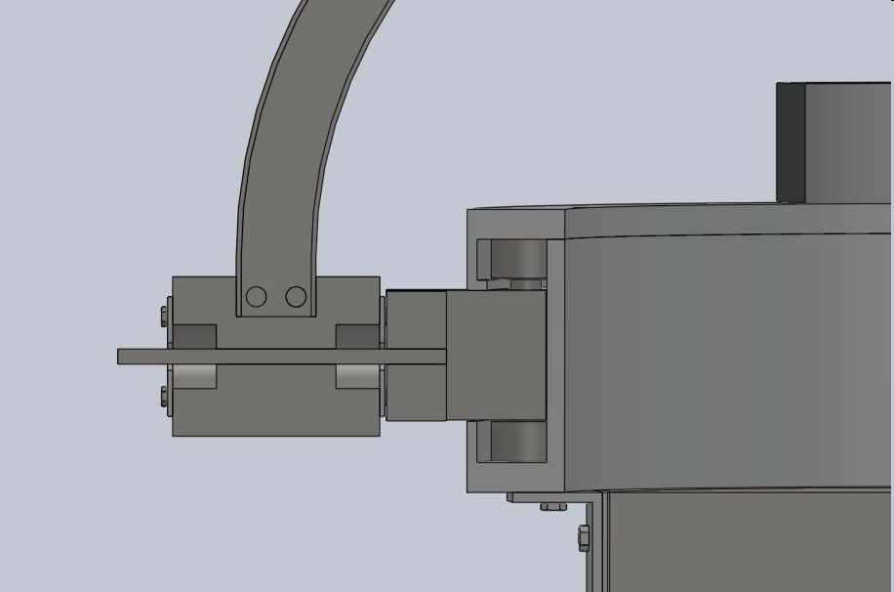
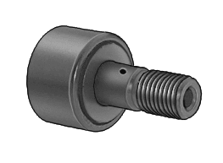
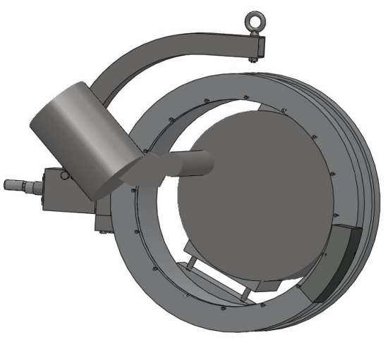
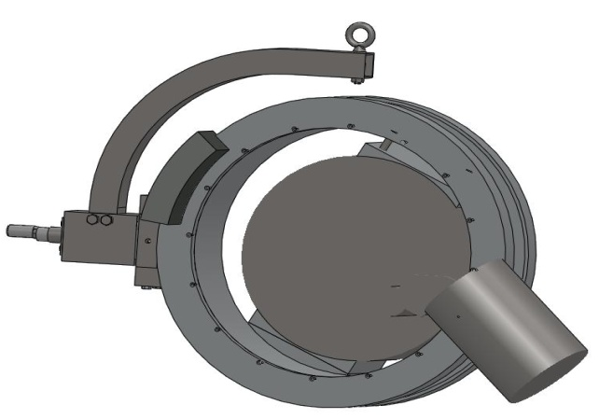
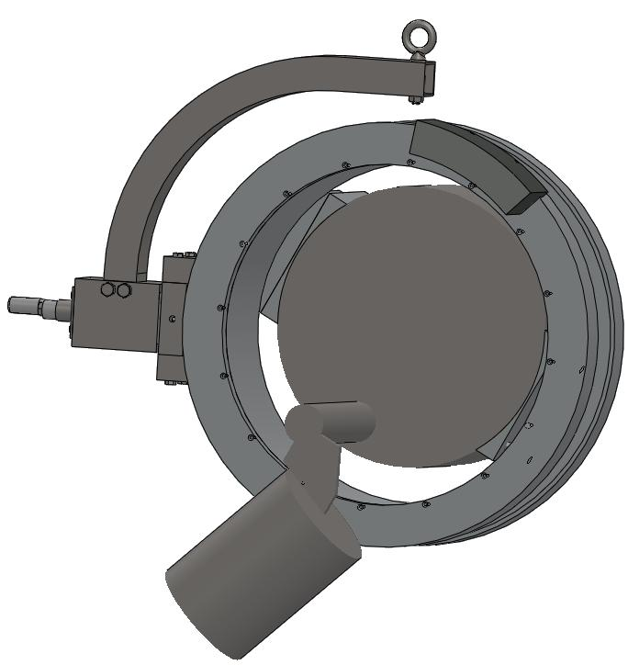
Rotating Drum about the Axle

Slide 12
Why is our manipulator better than others?
It meets all the design specifications; clamp, lift, tilt and rotate
It’s ergonomic; Optimally engineered so that when tilting or rotating, the brake drum feels weightless since we have designed it to rotate about the center of gravity therefore requiring little effort in maneuvering.
System pads can be assembled and disassembled to adapt to other brake drums.
The manipulator is made from off the shelf manufacturable materials and other pre-fabricated components to keep cost down and make interchangeability easy.

